Slide 1


DEPI Graduation supply chain quality
FULL PRESENTATION MADE BY : AHMED YASSER

Slide 2
OUR TEAM
ABEER AWAD
) Understanding data , developing analysis strategies (
MAHMOUD TOHAMY
( SC data collection, cleaning, dashboard ,mentor (
ABDALLAH REDA
(cleaning , Descriptive and predictive analytics(
AHMED YASSER
) Collect, clean and analyze HR data(

Slide 3
Table of contents
01
02
03
04
05
06
Data overview
Executive summary
Data gathering & exploration
Cleaning & modeling
Analysis Questions
Forecasting Questions

Slide 4
01
Data
overview

Slide 5
DATA OVER VIEW
In the beginning
The company has a wide customer base and is spread across more than one country.
It is an international company, not a local one.
Corporate customers constitute a large part of the customer base,
not individuals.
The company's affairs are carried out by many departments
that handle all stages of manufacturing.
The company can use the analysis of this data to improve marketing and sales strategies and customize products and services to better meet customer needs.

Slide 6
02
Executive summary

Slide 7
Executive summary
Project goal
The main objective of the project is to analyze the movement of shipments and to know if there are any malfunctions or problems with customers and manufacturing processes and to work on solving them and to analyze sales performance and employee performance.

Slide 8
Executive summary
Project key finding
I discovered that there is a significant and noticeable delay in the criticality of shipping orders, specifically when requesting a refund and the debit payment method,
and the collapse of orders in the last quarter of the year.
We will see if the frequent absence of employees is the reason and what is behind it.

Slide 9
Executive summary
Project recommendation
Improving shipping systems and payment methods by generalizing the least problematic methods, providing discounts, improving refund methods, appointing many employees in the sales department through the Indeed website, and enabling remote work.

Slide 10

03
Data gathering & exploration

Slide 11
Data gathering
The data used in this project was downloaded from Kaggle, where the data was in the form of a CSV file. The data included a set of variables related to shipments, sales, and employee performance, which are essential data for analyzing supply chain and human resources performance. And it contain on more than 180K
And 60 columns

Slide 12
Data exploration
When exploring the data, it was noted that the data was disorganized and contained several issues such as:
Missing Values: Some columns had a large number of missing values, which required taking action to either fill these values ​​or delete the affected rows based on the impact of these missing values ​​on the analysis.

Slide 13
Data exploration count…..
Duplicates: There were duplicate rows in the data, which required removing them to ensure that the analysis was based on accurate and reliable data.

Slide 14
Data exploration count…..
Unwanted Data: Some columns contained information that was not useful for the primary analysis, so these columns were excluded to avoid negatively impacting the results.

Slide 15
Data exploration count…..
Incorrect Data Types: Some columns had incorrect data types (such as storing dates as text), and these types were corrected to match the nature of the data.

Slide 16




Slide 17
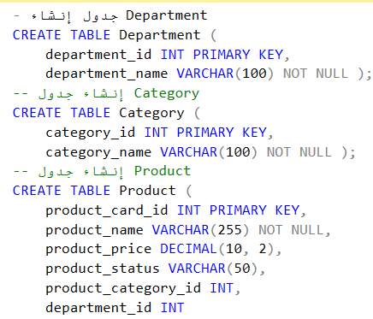
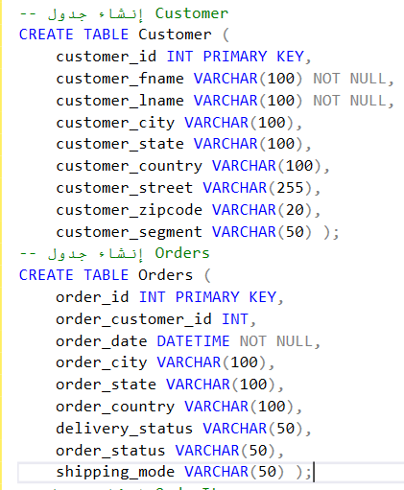
SQL
database creation

Slide 18
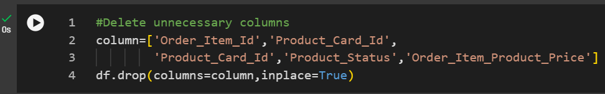


Supply chain data cleaning
Delete unnecessary columns
Correct data type
Correct data type

Slide 19
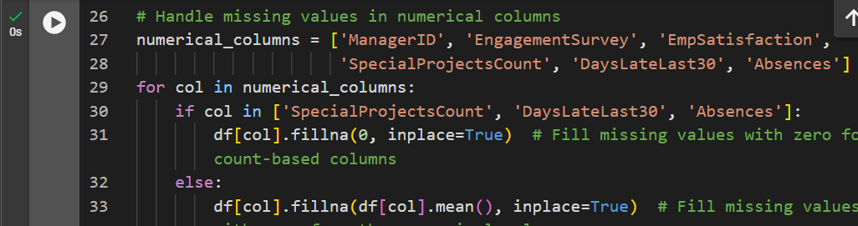
HR data cleaning
Sample of Processing and filling missing values ​​in columns

Slide 20
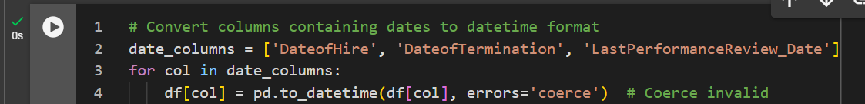
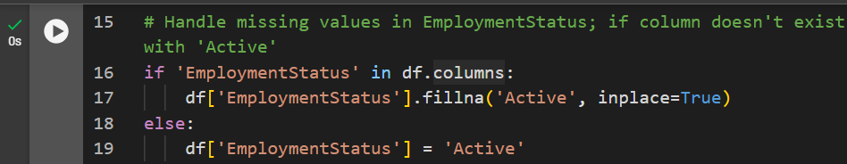
HR data cleaning count….
Sample of Processing and filling missing values ​​in columns

Slide 21
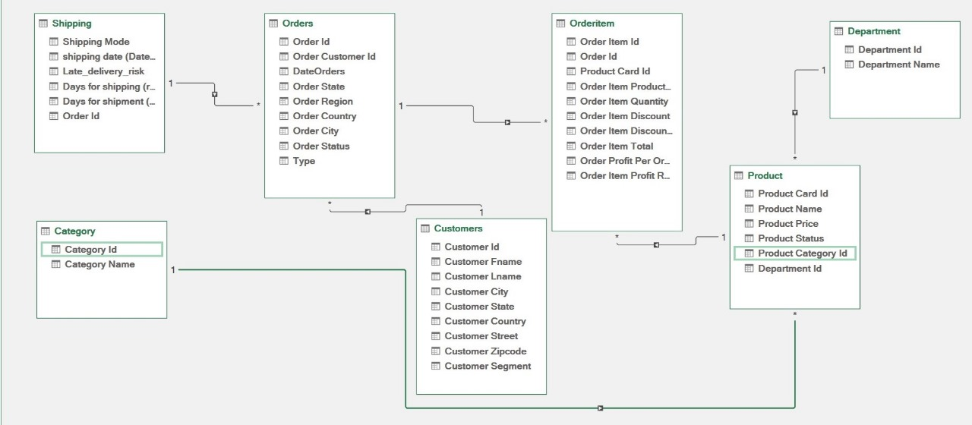
Data modeling

Slide 22



Slide 23
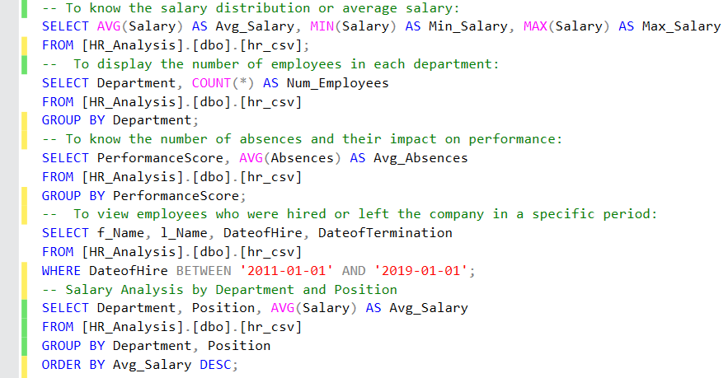
SQL queries

Slide 24
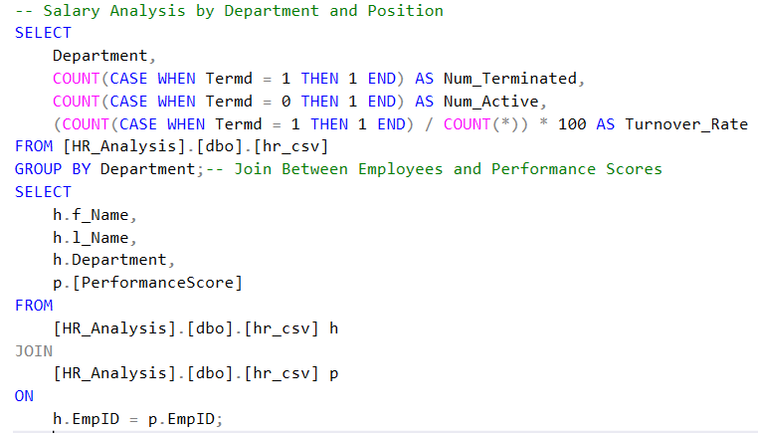
SQL queries count…

Slide 25
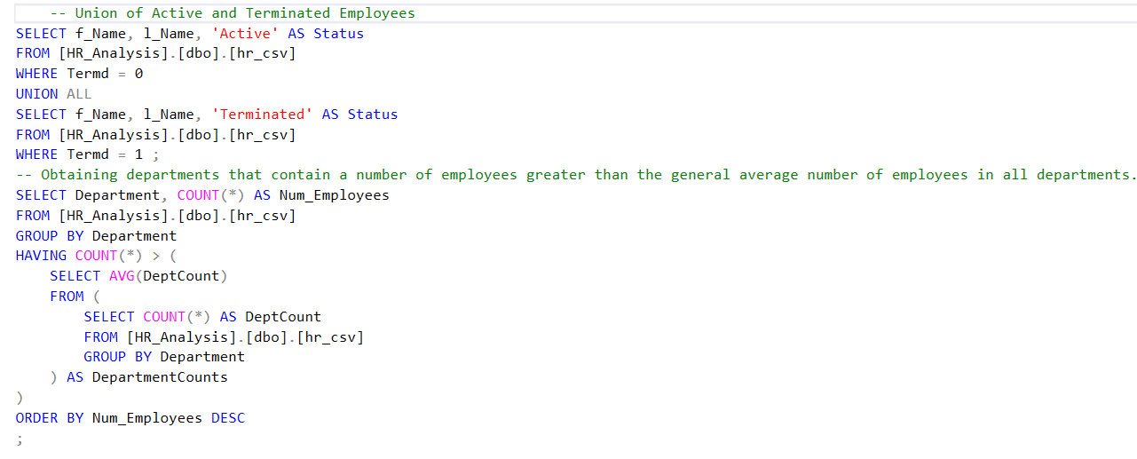
SQL queries count…

Slide 26
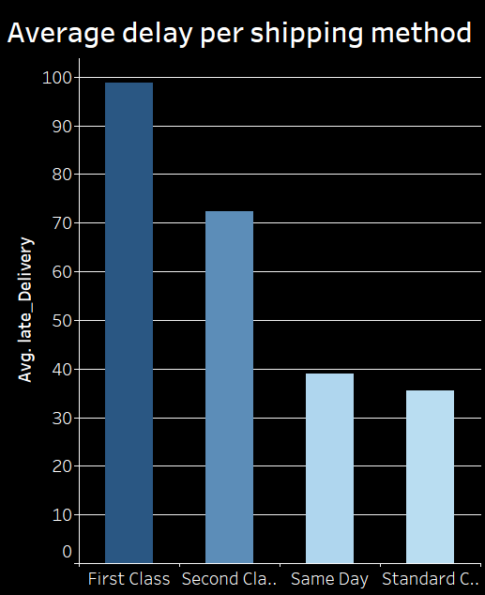
The graph above shows the relationship between shipping method and how late orders are to their scheduled delivery date. We can see that Priority shipping is the slowest, while Same Day shipping is the fastest.

Slide 27
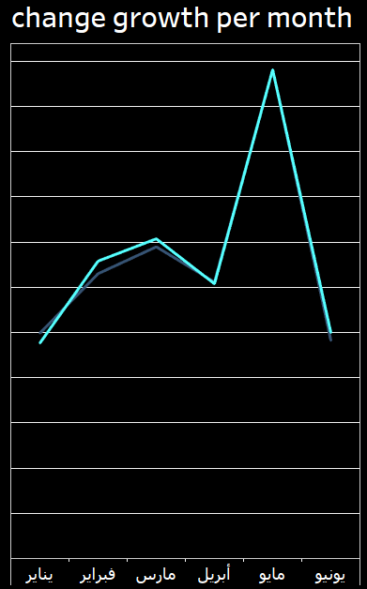
The graph above shows the relationship between the way orders move during the year. We notice that the dogs in January had the highest percentage while in November the percentage in the year was achieving sales.

Slide 28
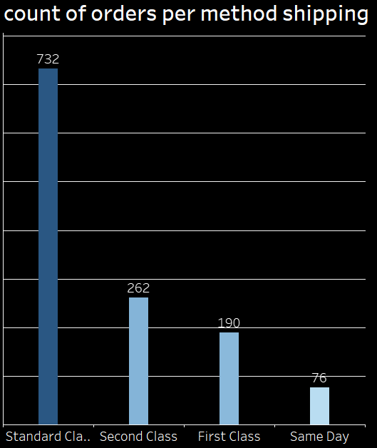
The graph shows the number of orders for each shipping method. The standard method is the most used, followed by the second method, then the first, and finally the same-day delivery method, which is the least used.

Slide 29
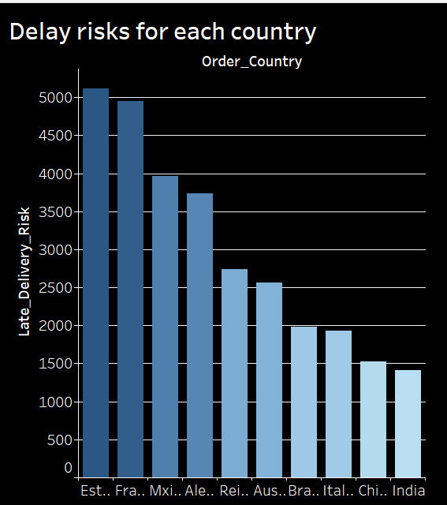
The graph shows the average number of days orders are delayed for each shipping method. The first method is the slowest, followed by the second method, then the standard method, and finally the same-day delivery method, which is the fastest.

Slide 30
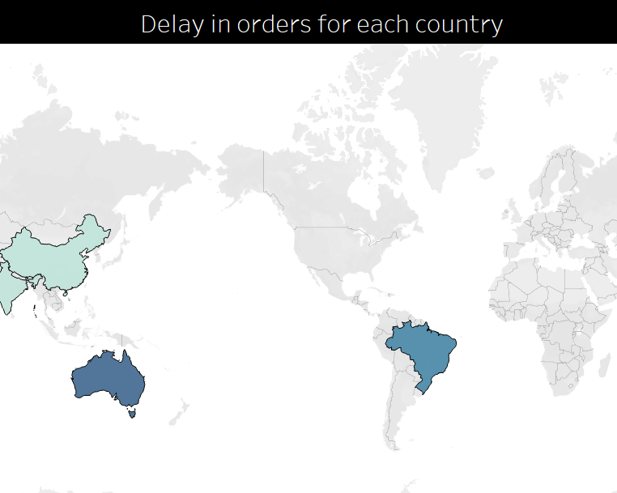
The map shows the average delay of requests in different countries. The colors indicate the level of delay, with lighter colors representing lower delays and darker colors representing higher delays. The map indicates that Australia and Brazil have higher delays compared to China and India.

Slide 31
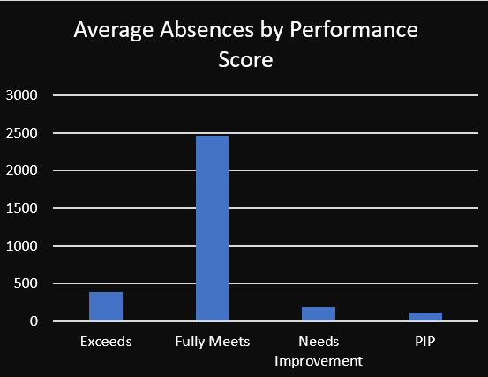
The graph shows the inverse relationship between employee performance and the number of days they are absent from work. Employees who perform well are the ones who are absent the least.

Slide 32
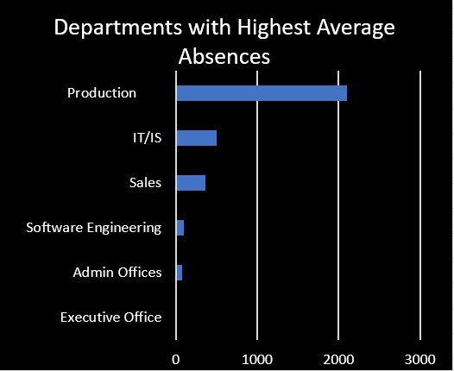
The graph shows that the production department is the department with the highest average number of days absent compared to other departments in the company, while the executive department has the lowest average number of days absent.

Slide 33



Slide 34
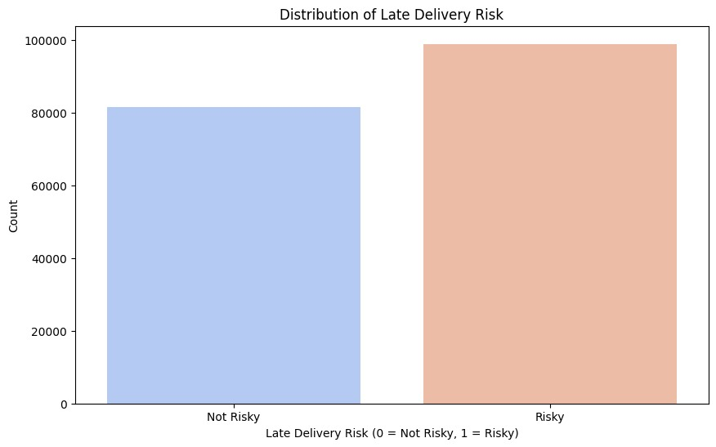
The graph shows the distribution of late delivery risks. It shows that the number of orders with a high risk of late delivery far exceeds the number of orders with a low risk.

Slide 35
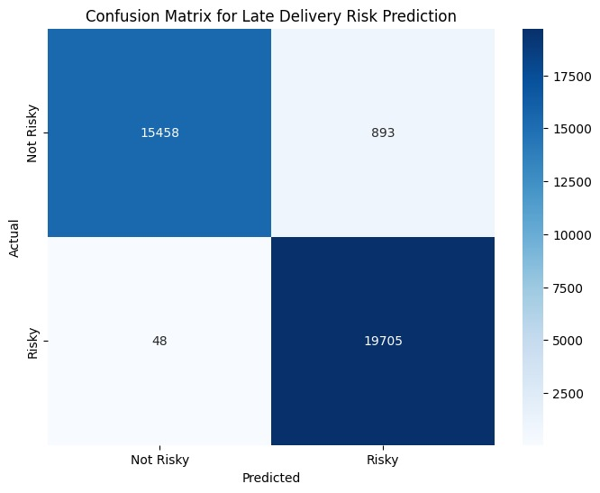
The confusion matrix shows that the late delivery prediction model performs well overall at classifying orders that will not be late, but has more difficulty classifying orders that will be late. In other words, the model is good at identifying orders that will arrive on time, but has a challenge at identifying orders that will be late.

Slide 36
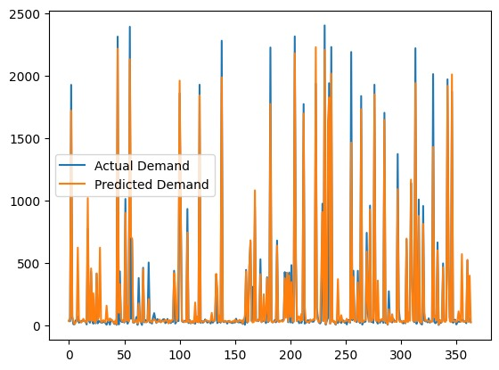
The graph shows a comparison between actual demand and forecast demand over time. It can be seen that there is a discrepancy between actual demand and forecast demand, indicating that the forecasting model used may not be accurate enough in all cases.

Slide 37

Question time

Slide 38
Thanks!

